Slide 1
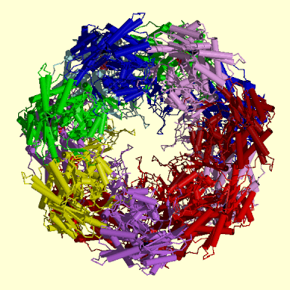
Protein Structure

Slide 2
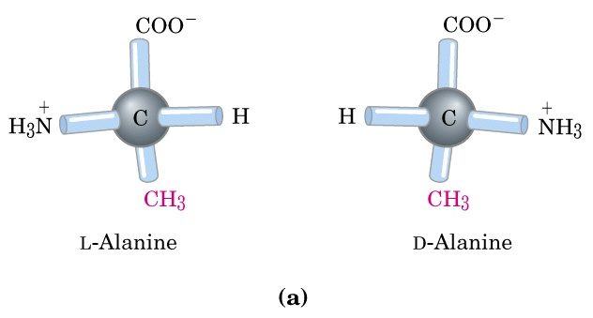

Slide 3
Stereoisomers of α amino acids
The two stereoisomers of alanine, L-, and D- are non superimposable mirror images (enantomers)
In proteins only L- configuration is found
Cell are able to synthesize L isomers in stereospecific reactions.

Slide 4
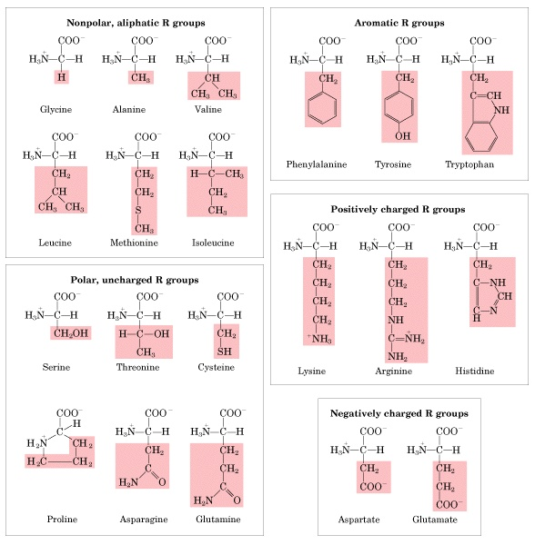
Amino acids are classified by R-group

Slide 5
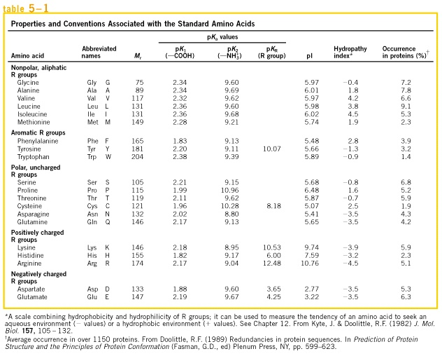

Slide 6
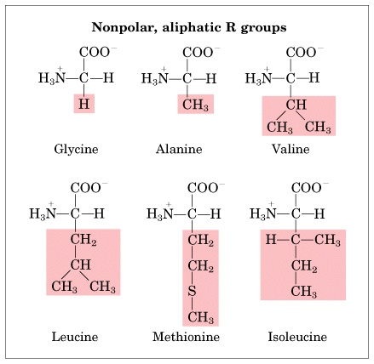

Slide 7
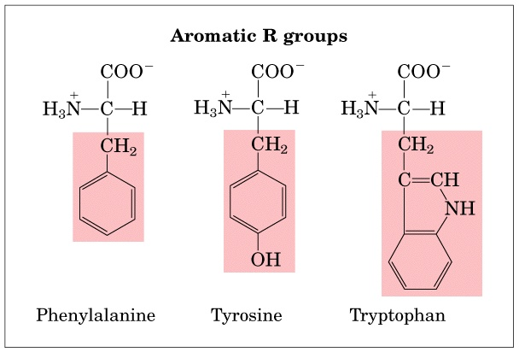

Slide 8
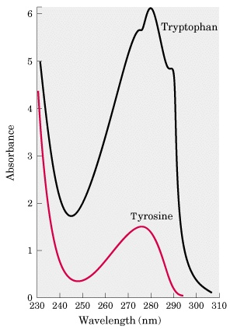

Slide 9
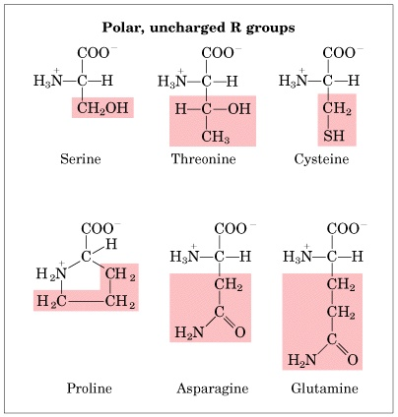

Slide 10
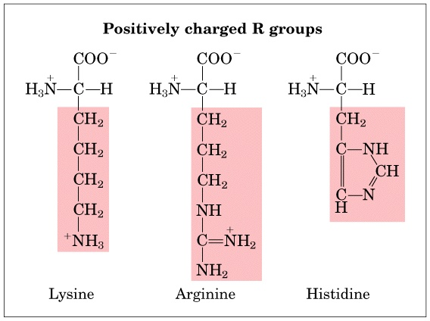

Slide 11
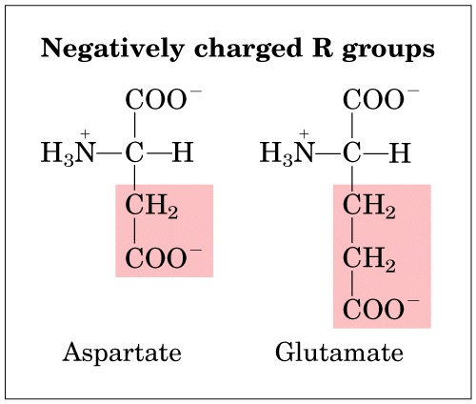

Slide 12
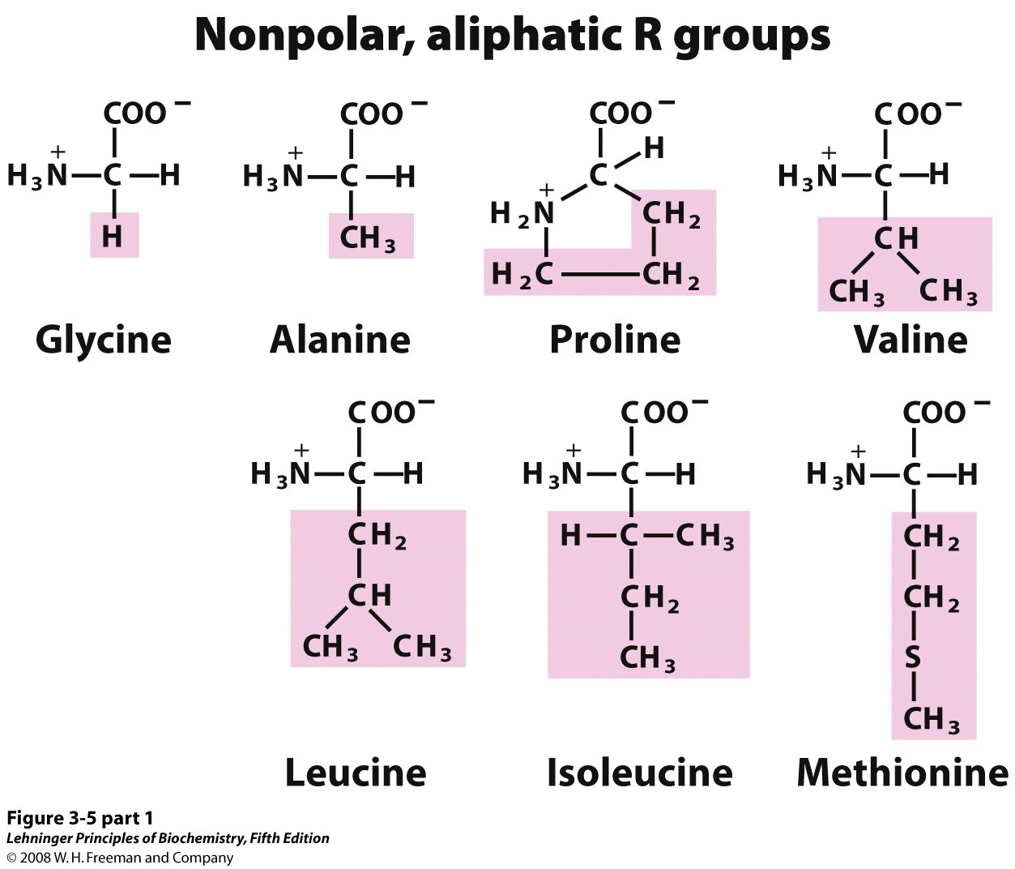
Notes:
FIGURE 3-5 (part 1) The 20 common amino acids of proteins. The structural formulas show the state of ionization that would predominate at pH 7.0. The unshaded portions are those common to all the amino acids; the portions shaded in pink are the R groups. Although the R group of histidine is shown uncharged, its pK_{a} (see Table 3-1) is such that a small but significant fraction of these groups are positively charged at pH 7.0. The protonated form of histidine is shown above the graph in Figure 3-12b.

Slide 13
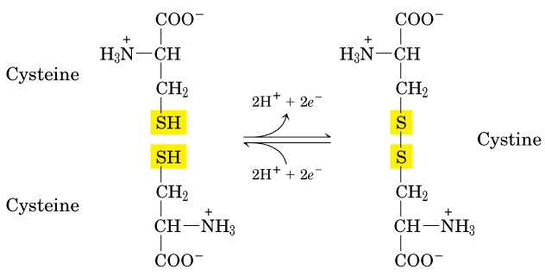

Slide 14
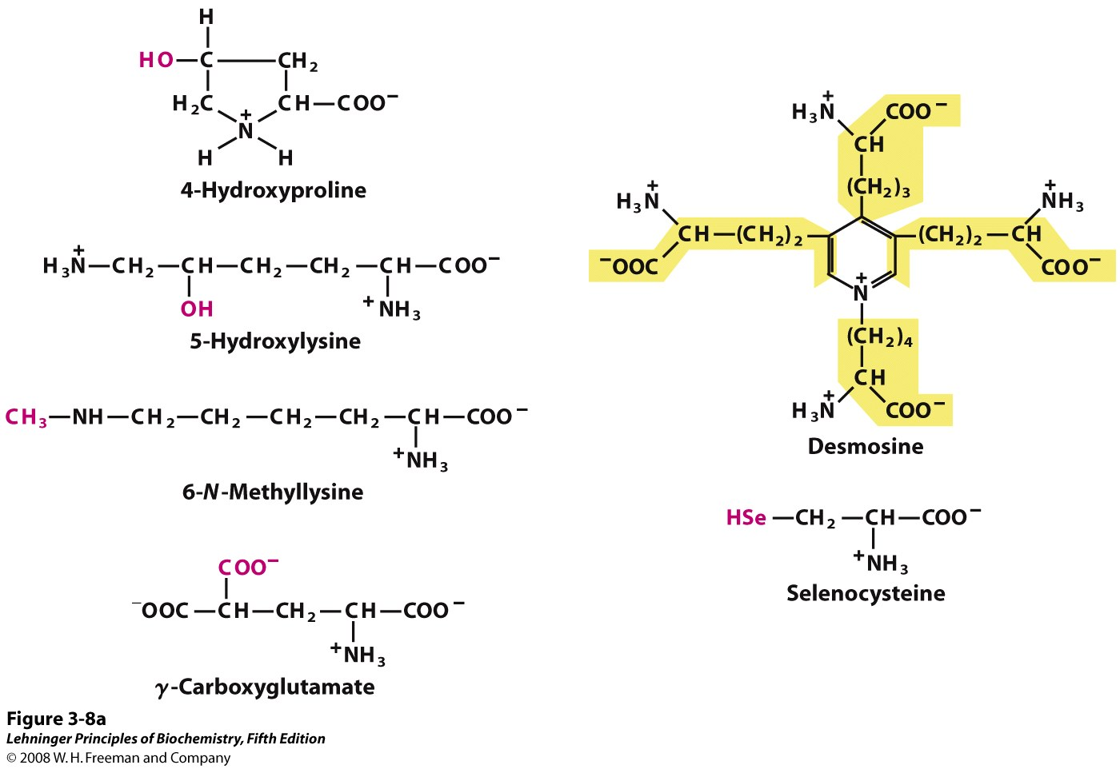
Notes:
FIGURE 3-8a Uncommon amino acids. (a) Some uncommon amino acids found in proteins. All are derived from common amino acids. Extra functional groups added by modification reactions are shown in red. Desmosine is formed from four Lys residues (the four carbon backbones are shaded in yellow). Note the use of either numbers or Greek letters to identify the carbon atoms in these structures.

Slide 15
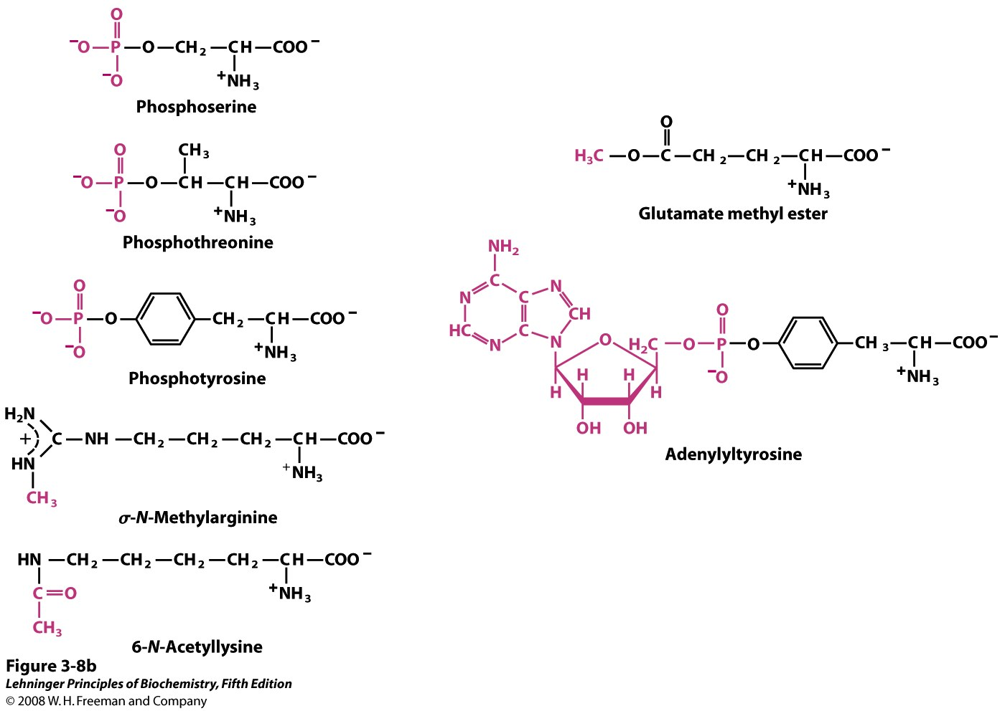
Notes:
FIGURE 3-8b Uncommon amino acids. (b) Reversible amino acid modifications involved in regulation of protein activity. Phosphorylation is the most common type of regulatory modification.

Slide 16
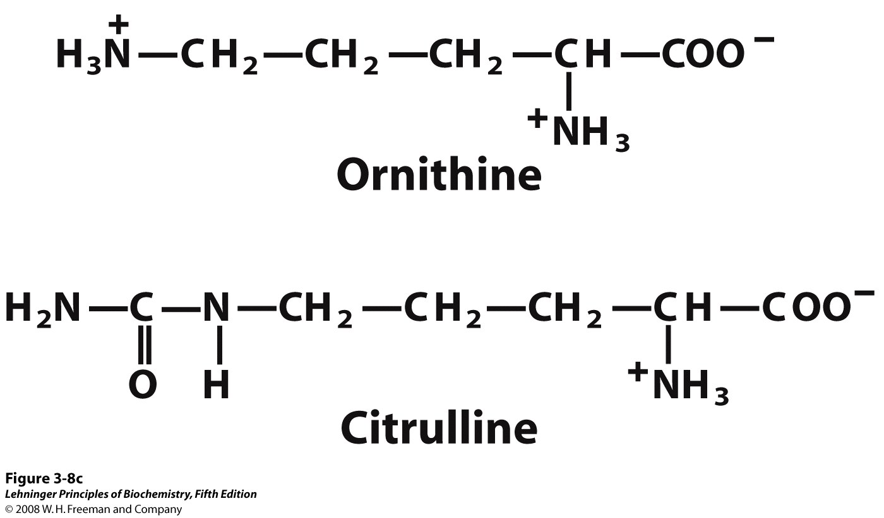
Notes:
FIGURE 3-8c Uncommon amino acids. (c) Ornithine and citrulline, which are not found in proteins, are intermediates in the biosynthesis of arginine and in the urea cycle.

Slide 17
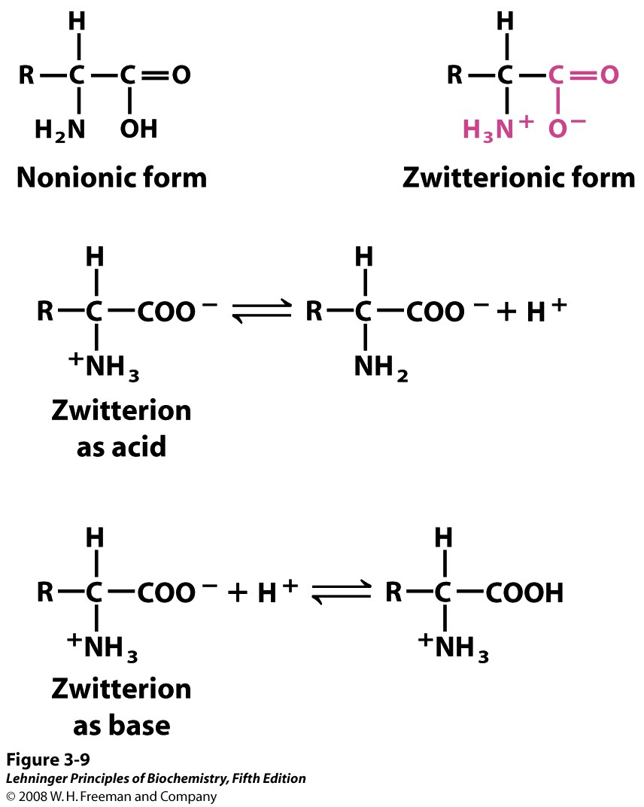
Notes:
FIGURE 3-9 Nonionic and zwitterionic forms of amino acids. The nonionic form does not occur in significant amounts in aqueous solutions. The zwitterion predominates at neutral pH. A zwitterion can act as either an acid (proton donor) or a base (proton acceptor).

Slide 18
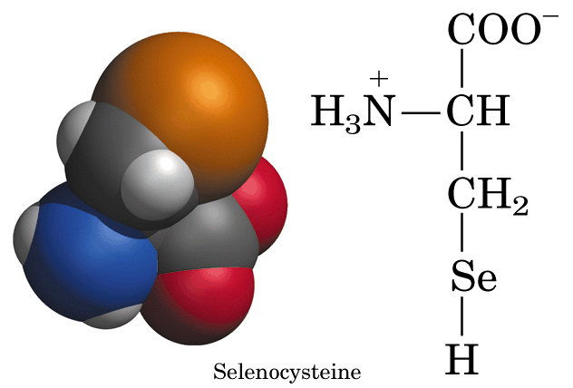
Nonstandard amino acids have important functions
Selenocysteine: -derived from serine is found in handful of proteins.
Ornithine and citrulline: are not part of the proteins, but rather are key intermediates in the synthesis of arginine.

Slide 19
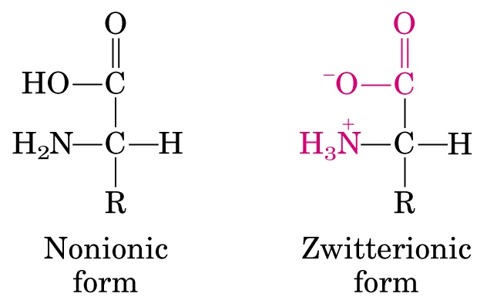

Amino acids are weak acids and bases
Zwitterion: “hybrid ion” can act as acid (proton donor) or base (proton acceptor)
COOH ⁺ NH₃ Net Charge: +1
COO⁻ ⁺ NH₃ Net Charge: 0
COO ⁻ NH₂ Net Charge: -1

Slide 20
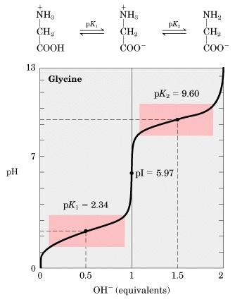

Slide 21
Isoelectric point, (pI)
At pH 5.97 glycine is fully ionized
It has no NET electric charge
Isoelectric point of glycine:
  pI=1/2 (pK_{a1} +pK_{a2})=1/2(2.34+9.60)=5.97
  At pH=5.97 glycine has no net charge!

Slide 23
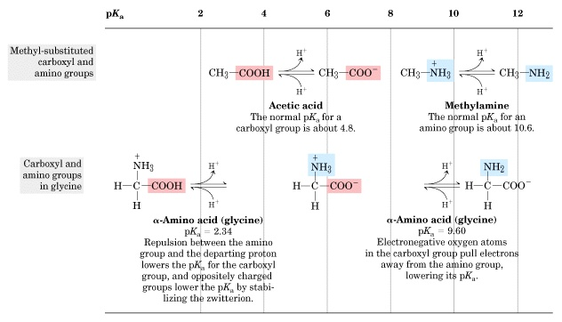

Slide 24
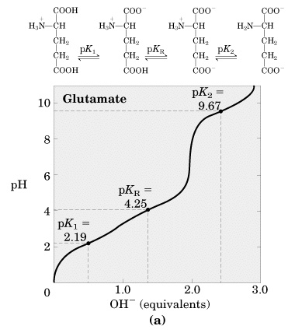

Slide 25
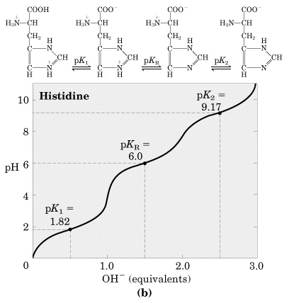

Slide 26
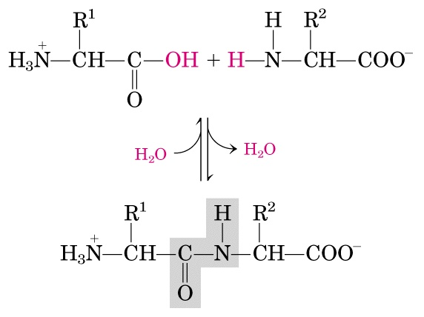

Slide 27
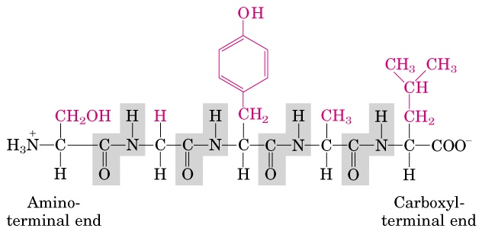

Slide 28
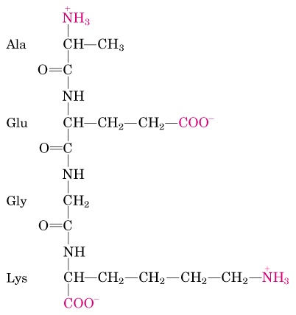

Slide 29
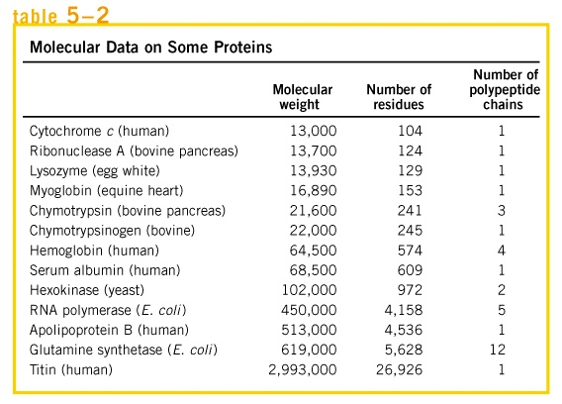
Biologically active peptides
  Oligomeric
  Protomeric
Hormones
Glutathione
Ubiquitin

Slide 30
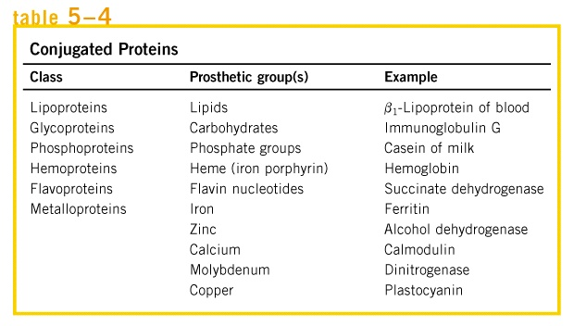

Slide 31
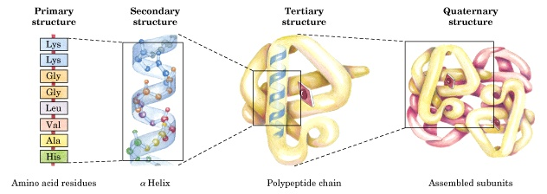

Slide 32
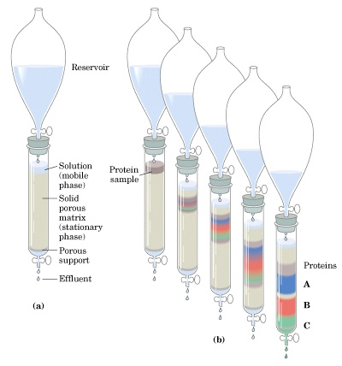

Slide 33
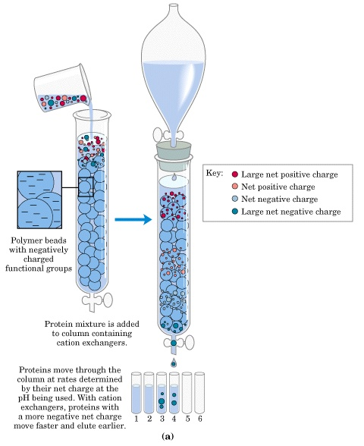

Slide 34
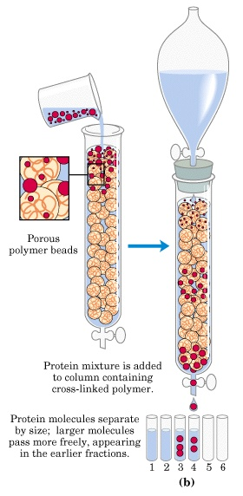

Slide 35
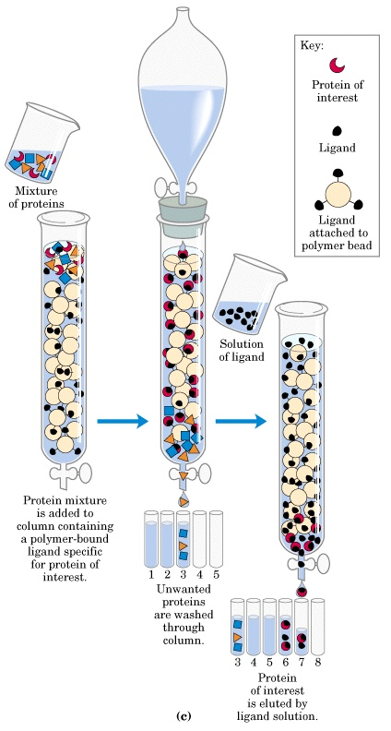

Slide 36
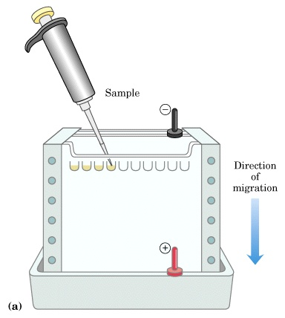

Slide 37
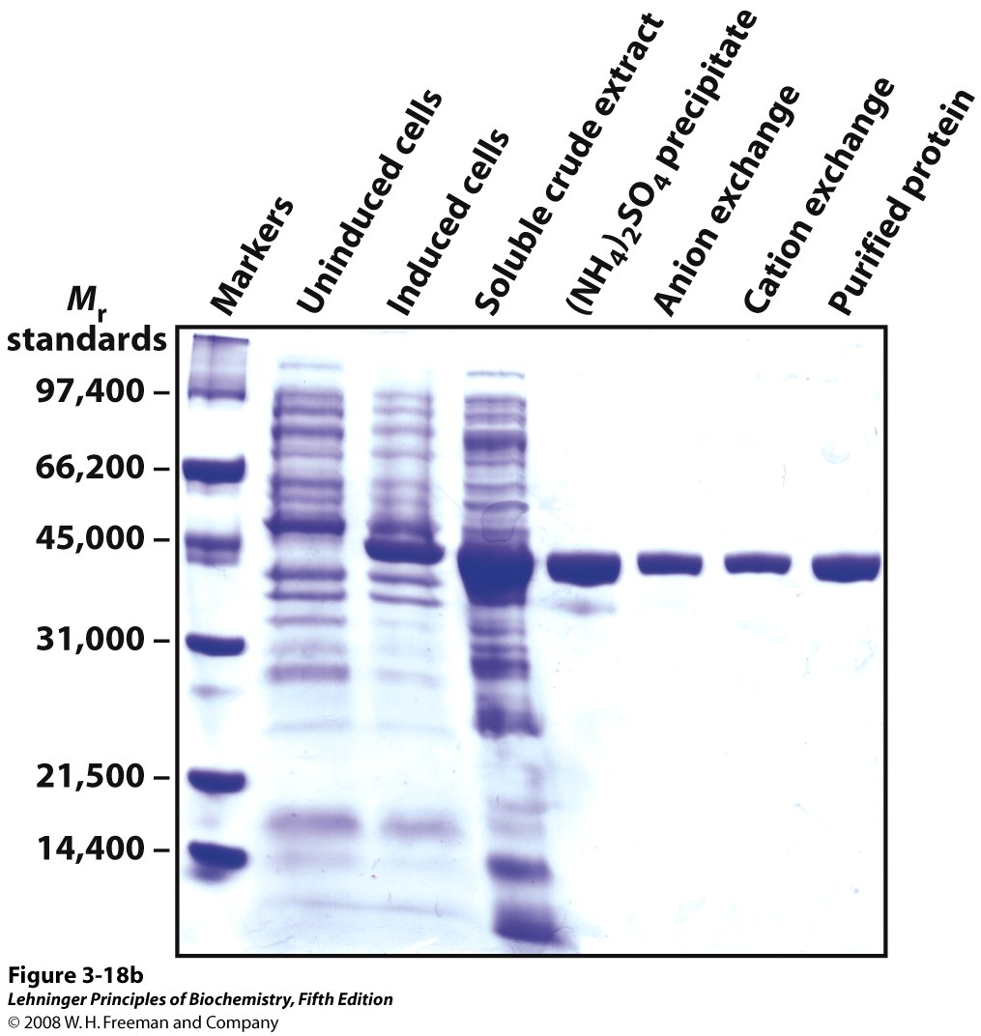
Notes:
FIGURE 3-18b Electrophoresis. (b) Proteins can be visualized after electrophoresis by treating the gel with a stain such as Coomassie blue, which binds to the proteins but not to the gel itself. Each band on the gel represents a different protein (or protein subunit); smaller proteins move through the gel more rapidly than larger proteins and therefore are found nearer the bottom of the gel. This gel illustrates purification of the RecA protein of Escherichia coli (described in Chapter 25). The gene for the RecA protein was cloned (Chapter 9) so that its expression (synthesis of the protein) could be controlled. The first lane shows a set of standard proteins (of known M_{r}), serving as molecular weight markers. The next two lanes show proteins from E. coli cells before and after synthesis of RecA protein was induced. The fourth lane shows the proteins in a crude cellular extract. Subsequent lanes (left to right) show the proteins present after successive purification steps. The purified protein is a single polypeptide chain (M_{r} ~38,000), as seen in the rightmost lane.

Slide 38
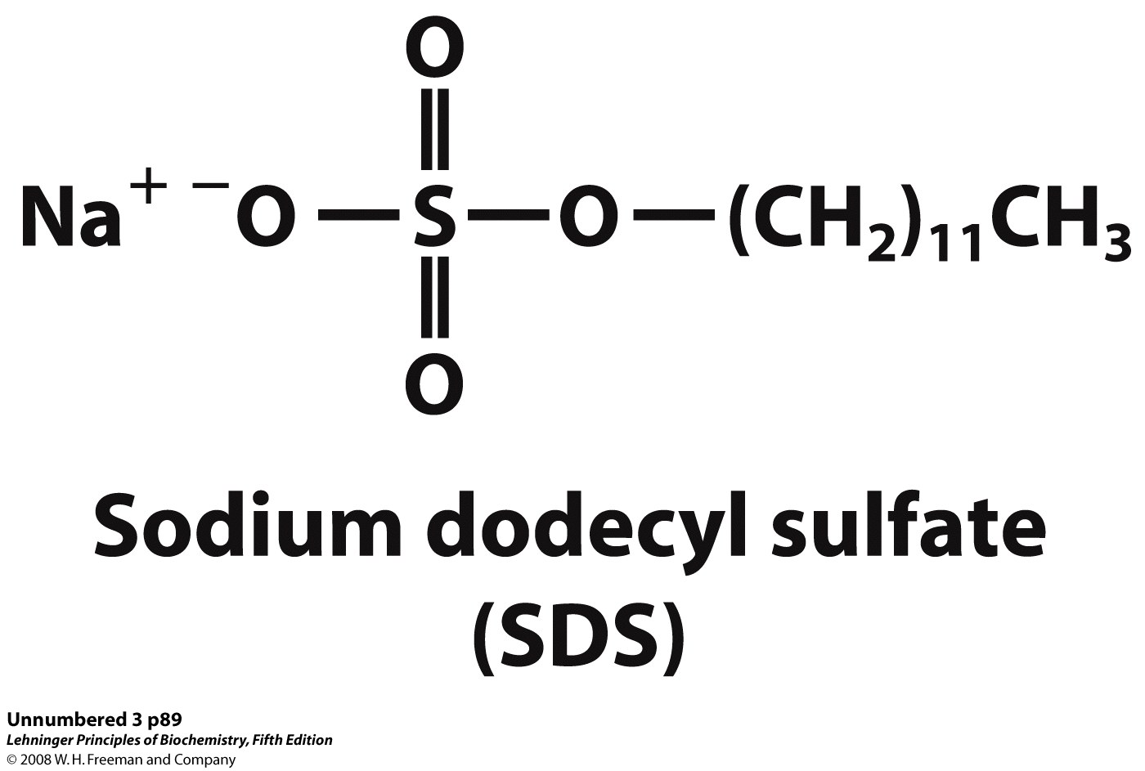

Slide 39
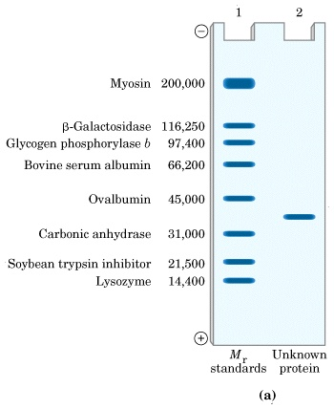
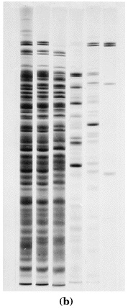

Slide 40
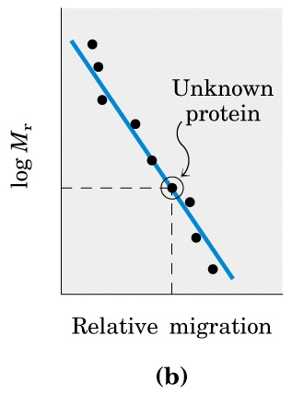

Slide 41
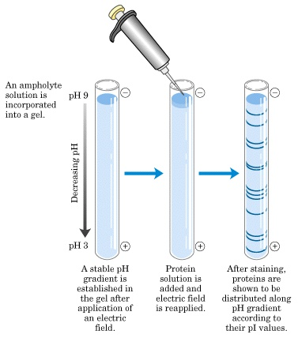

Slide 42
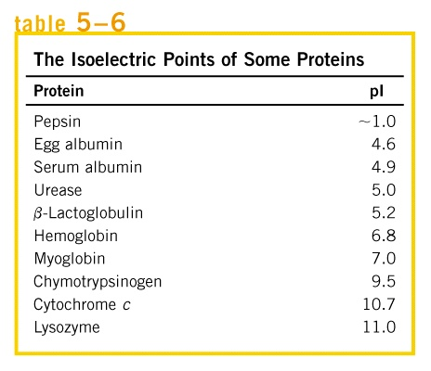

Slide 43
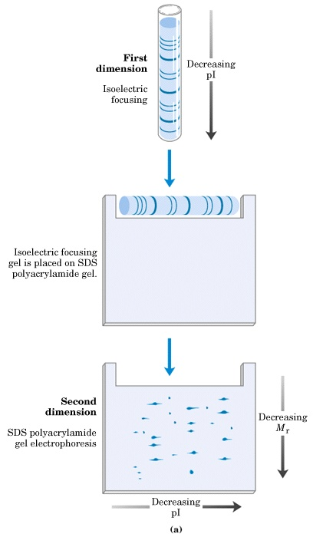

Slide 44
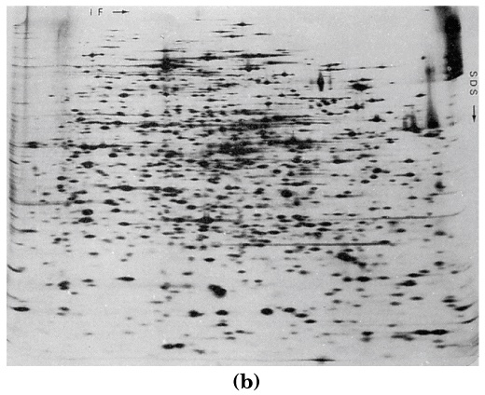

Slide 45
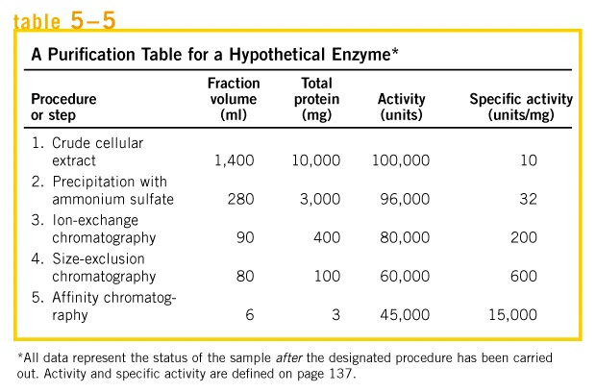

Slide 46
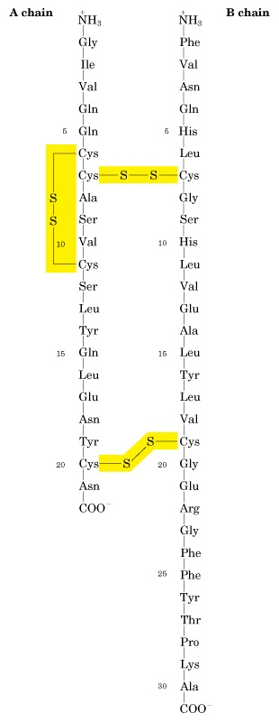

Slide 47
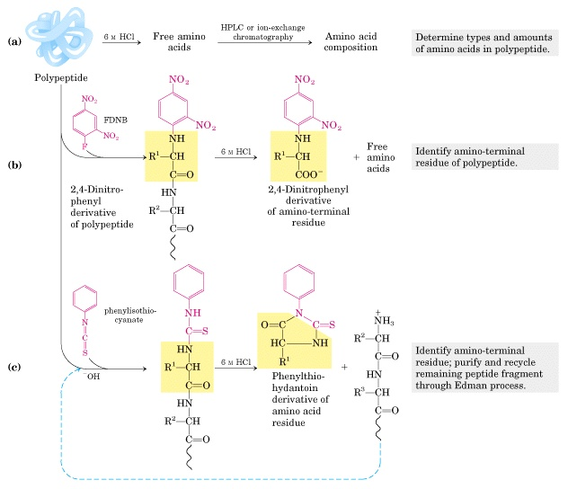

Slide 48
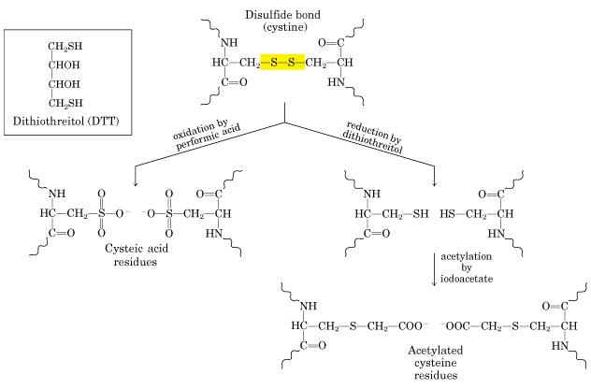

Slide 49
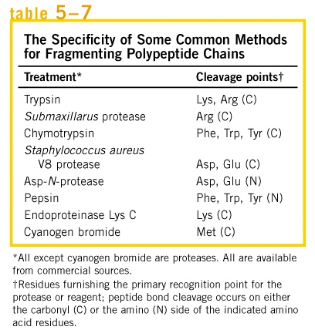

Slide 50
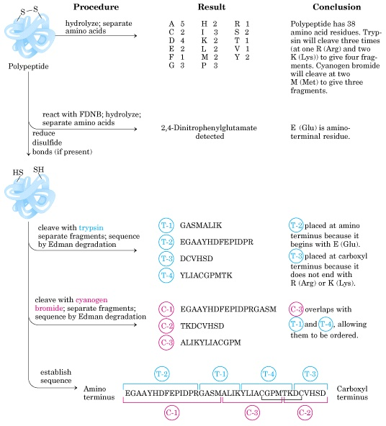

Slide 51
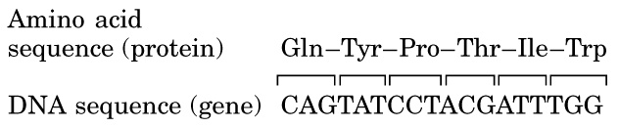

Slide 52
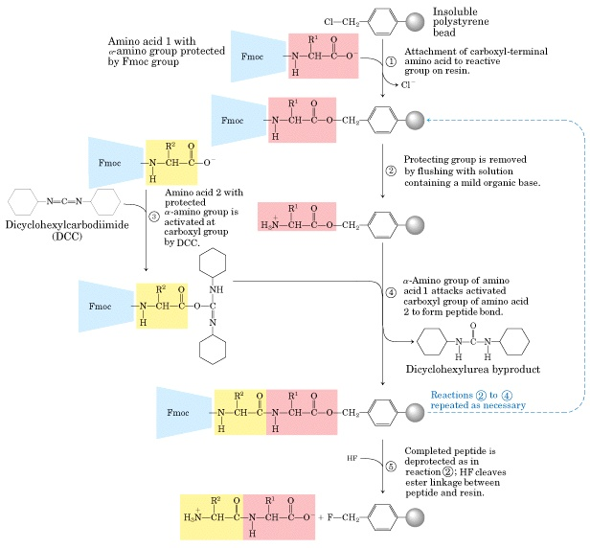

Slide 53


Slide 54


Slide 55


Slide 56


Slide 57


Slide 58


